Slide 1
Preimplantation genetic diagnosis PGD

Slide 2
Chromosomal PGD is done in the setting of IVF
It enables an unaffected embryo to be transferred to the uterus, few days postconception
For couples facing a high genetic risk, the risk can be bypassed; and the prospect of pregnancy termination for the reason of genetic abnormality can be avoided

Slide 3
PGD is applied in two main settings:
Diagnosis of chromosome abnormalities (FISH)
Detection of a Mendelian condition (DNA testing)
DNA-based methodologies are now the mainstay in both categories

Slide 4
Patients and circumstances where chromosomal PGD may be appropriate:
I. Carriers of Balanced Rearrangements
A parent who is the carrier of a balanced rearrangement typically has a high risk to produce unbalanced embryos
several miscarriages
terminations following conventional prenatal diagnosis of an unbalanced fetal karyotype

Slide 5
II. Preimplantation Genetic Screening (PGS)
Evaluating embryos for chromosome aneuploidy in chromosomally normal parents
Rationale behind PGS:
Proportion of IVF embryos that result in pregnancy is quite low (less than 30%), IVF clinics sought embryos with best chances of resulting in pregnancy
Substantial number of human embryos are aneuploid, and certain patient populations, including couples of advanced maternal age, or with histories of recurrent miscarriage and repeated implantation failure, may be predisposed to producing aneuploid embryos
PGS is also used for couples who had a chromosomally abnormal pregnancy, fertile couple: questionable, couples already using IVF because of infertility: appropriate

Slide 6
III. Gender Selection
May be appropriate in the context of a sex-related genetic risk. This is likely to decline as direct gene testing becomes feasible for more sex-linked disorders
Males affected by an X-linked disease who wish to avoid transmitting the faulty gene to their (female) offspring, a circumstance in which sex selection can substitute perfectly for a direct gene test

Slide 7
Three types of PGD biopsy, done at three sequential stages of gametic and embryonic development:
Polar body biopsy
Blastomere biopsy
Blastocyst (trophectoderm) biopsy

Slide 8
Polar Body Analysis
Preconception diagnosis. PB analysis allows a focus on the vulnerable gamete, the ovum, the great majority of segregation errors occur here. Disomic or nullisomic gametes could be identified, and thus excluded from fertilization.
A theoretical advantage of PB diagnosis is that the uncertainty relating to aneuploidy screening at PGD, due to biopsy of a possibly unrepresentative aneuploid blastomere, could be avoided
Abnormalities arising in paternal meiosis, estimated to represent about 10% of aneuploidies, will not be detected

Slide 9
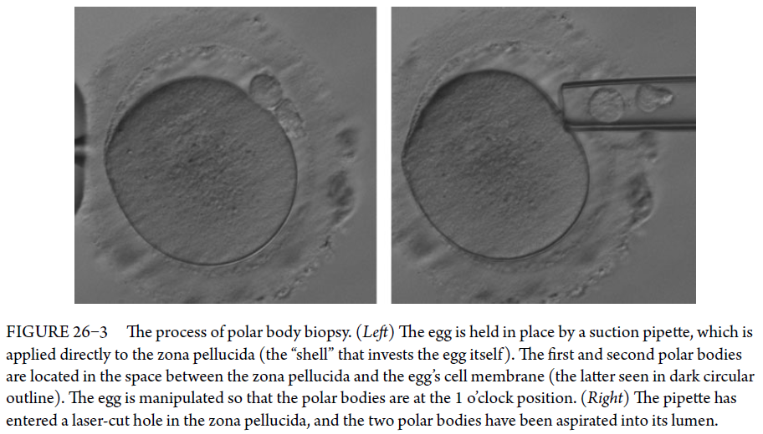

Slide 10
Cleavage Stage Biopsy (Day-3 Biopsy of a Blastomere)
On day 3, one or at most two cells (blastomeres) are removed from each Embryo

Slide 11
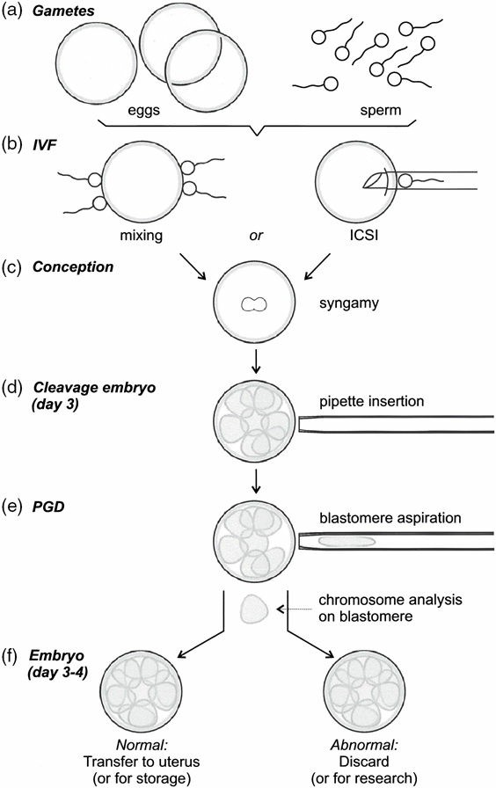
FIGURE 26–1 The process of in vitro fertilization (IVF) and preimplantation genetic diagnosis (PGD) at the day-3 stage.
Oöcytes are obtained from the woman, and sperm from the man (by testicular aspiration, if necessary)
Oöcytes and sperm are mixed in vitro; or, single sperm are injected into an oöcyte (ICSI)
Syngamy, the fusion of male and female pronuclei, occurs.
After incubation for 3 days, one or two blastomeres are removed from the embryo
these cells are then subject to chromosomal analysis
Normal (or balanced) embryos are chosen for transfer to the uterus, or possibly for cryopreservation for a future transfer

Slide 12
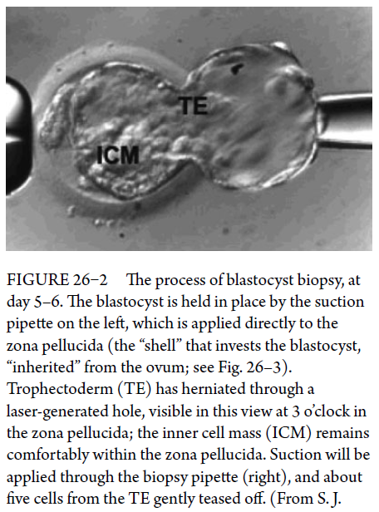
Blastocyst Stage Biopsy (Day-5 or -6 Biopsy of Trophectoderm)
If the embryo is incubated for 2 or 3 more days, it advances through the morula (day 4) and early blastocyst (days 5 and 6) stages
Culture to blastocyst, may effectively act as a form of selection in favor of euploid embryos

Slide 13
Implantation seems more successful following blastocyst than cleavage-stage biopsy
One study showed equivalent implantation for biopsied and nonbiopsied embryos at the blastocyst stage, but reduced implantation for embryos biopsied at cleavage-stage compared to nonbiopsied embryos
Thus, clinical pregnancy rates should be higher for biopsied blastocysts than for cleavage-stage embryos

Slide 14
Another attraction in delaying PGD until the blastocyst is forming is that cell number has increased, and differentiation between inner cell mass (which develops into the fetus) and trophoblast (which develops into the placenta) has begun, allowing sampling to be focused on the trophectoderm (in a tissue-origin sense, a very early chorionic villus sampling)
Trophectoderm biopsy typically involves removal of between two and seven cells, providing more copies of DNA template for use in testing, compared to cleavage-stage biopsy

Slide 15
A counterpoint to the perceived merits of blastocyst biopsy is the fact that some viable embryos may not survive during culture in vitro between the cleavage and blastocyst stages
Maternal genital tract offers a better environment than does an IVF container, and a better chance for survival; and so, the sooner the embryo could take up residence in its natural home, the better
And a controversial question is whether this longer incubation in vitro might disturb the epigenetic state of the embryo.

Slide 16
Genetic analysis of biopsied cells
Factors for consideration in choosing methods:
Time required to perform the test
Ability of test to detect a range of abnormalities
Equipment and reagent cost
Test complexity
Cost of analysis is particularly relevant in PGD (in contrast to prenatal and postnatal chromosome analysis) because of the need to test multiple embryos for each IVF cycle, with one or two tests performed per embryo

Slide 17
Analysis methods:
Old methods:
Metaphase chromosome analysis
Fluorescence in situ hybridization
Comparative Genomic Hybridization
Current methods:
Array Comparative Genomic Hybridization
Real-Time Quantitative PCR
SNP Microarray (“Karyomapping”)
Next-Generation Sequencing

Slide 18
Does PGD carry any risks to the embryo and to the child?
Three categories of potential risk:
A small risk of an embryo not surviving the biopsy process (<0.5%)
Ongoing question of whether the biopsy procedure itself might lead to reduced viability of biopsied embryos, compared to nonbiopsied embryos
Child born from a PGD pregnancy

Slide 19
There are differences in health between children conceived by IVF (without PGD) and naturally conceived children
IVF-conceived babies are at increased risk of:
low birth weight
preterm birth
perinatal mortality
birth defects
In the longer term, the health of IVF young adult appears to be similar to that of their in vivo conceived counterparts
To date, outcomes in PGD pregnancies have not been substantially different from those of IVF pregnancies; and thus we may conclude that, in fact, there is likely no detrimental effect of embryo biopsy per se

